Slide 1
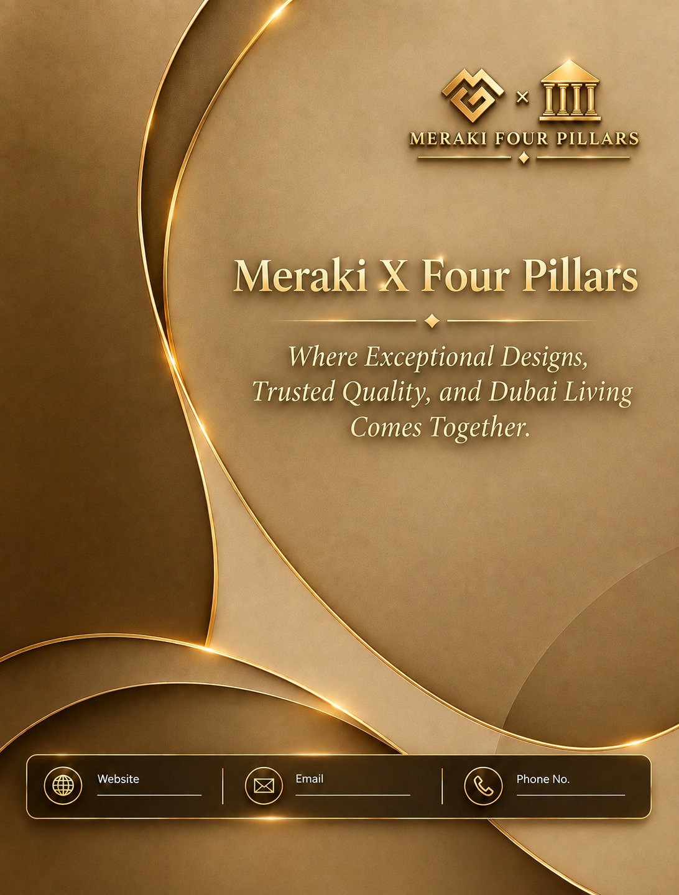

Slide 2
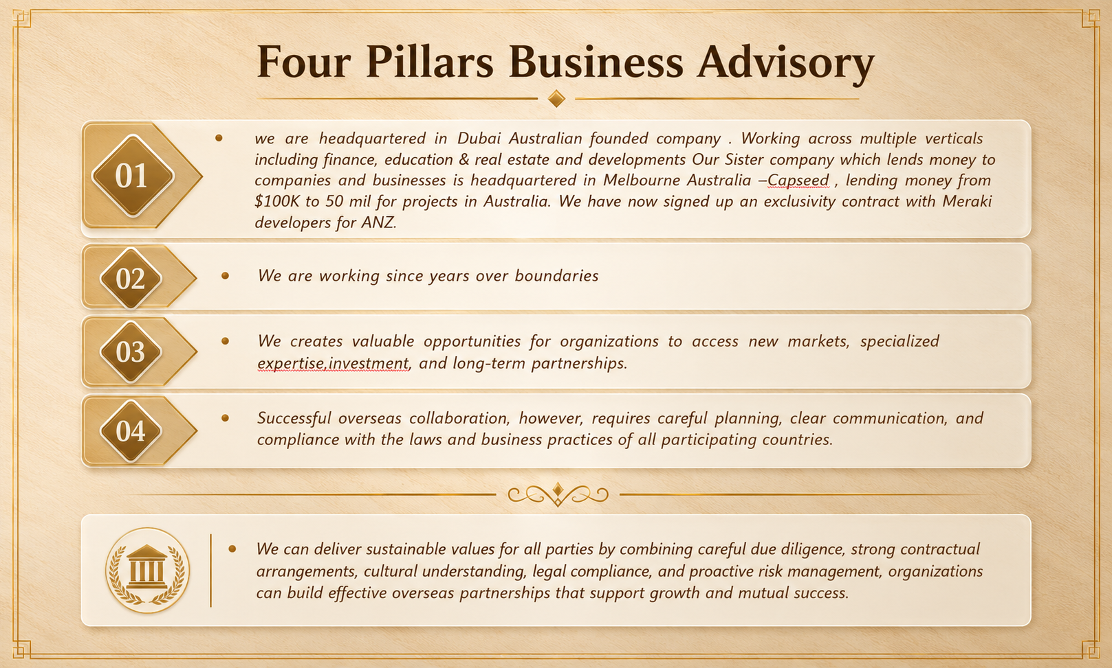

Slide 3
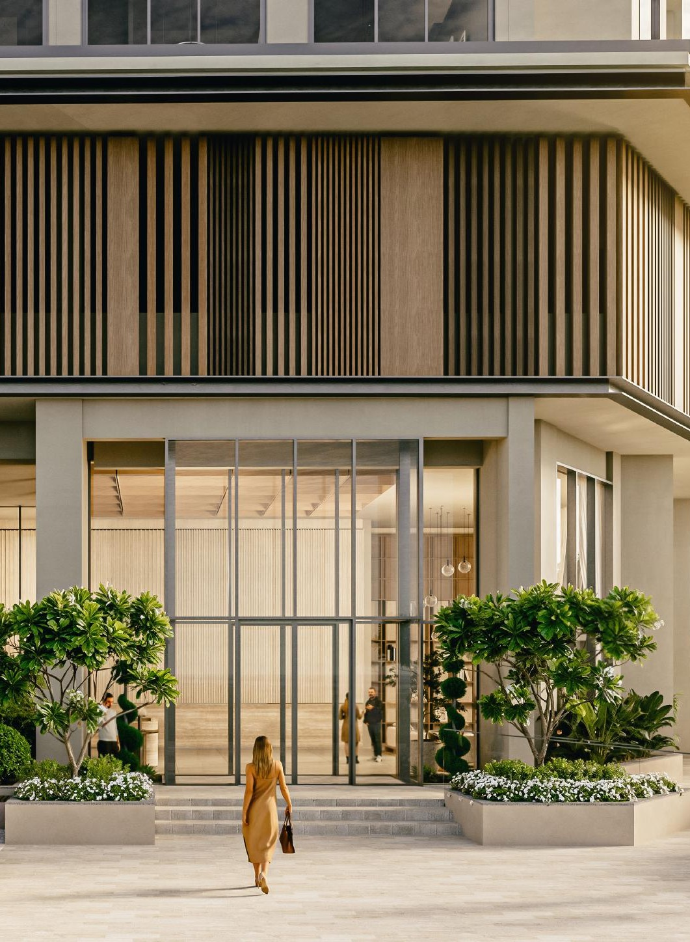
THE DEVELOPER
About Meraki
Developers
Meraki Developers is an award-winning real estate developer with a strong customer focus and meticulous attention to detail. We are committed to building communities that enhance quality of life — designing spaces that integrate natural elements, encourage social interaction, and support overall well-being.
Through our vertically-integrated development model we consistently deliver high-quality projects on time. With over 100 developments completed — residential towers, commercial buildings, industrial and villa projects — Meraki is known for excellence in design, sustainability, and execution.
Design & Engineering
MEP Contracting
Civil Contracting
Aluminum & Glazing
Structural Steel
03

Slide 4
Developers Projects
2017
2022
2024
2025
2026
2026
Meraki Genesis
The Haven
The Haven II
The Haven III
Nirvana Residences I
(More to Follow)
04

Slide 5
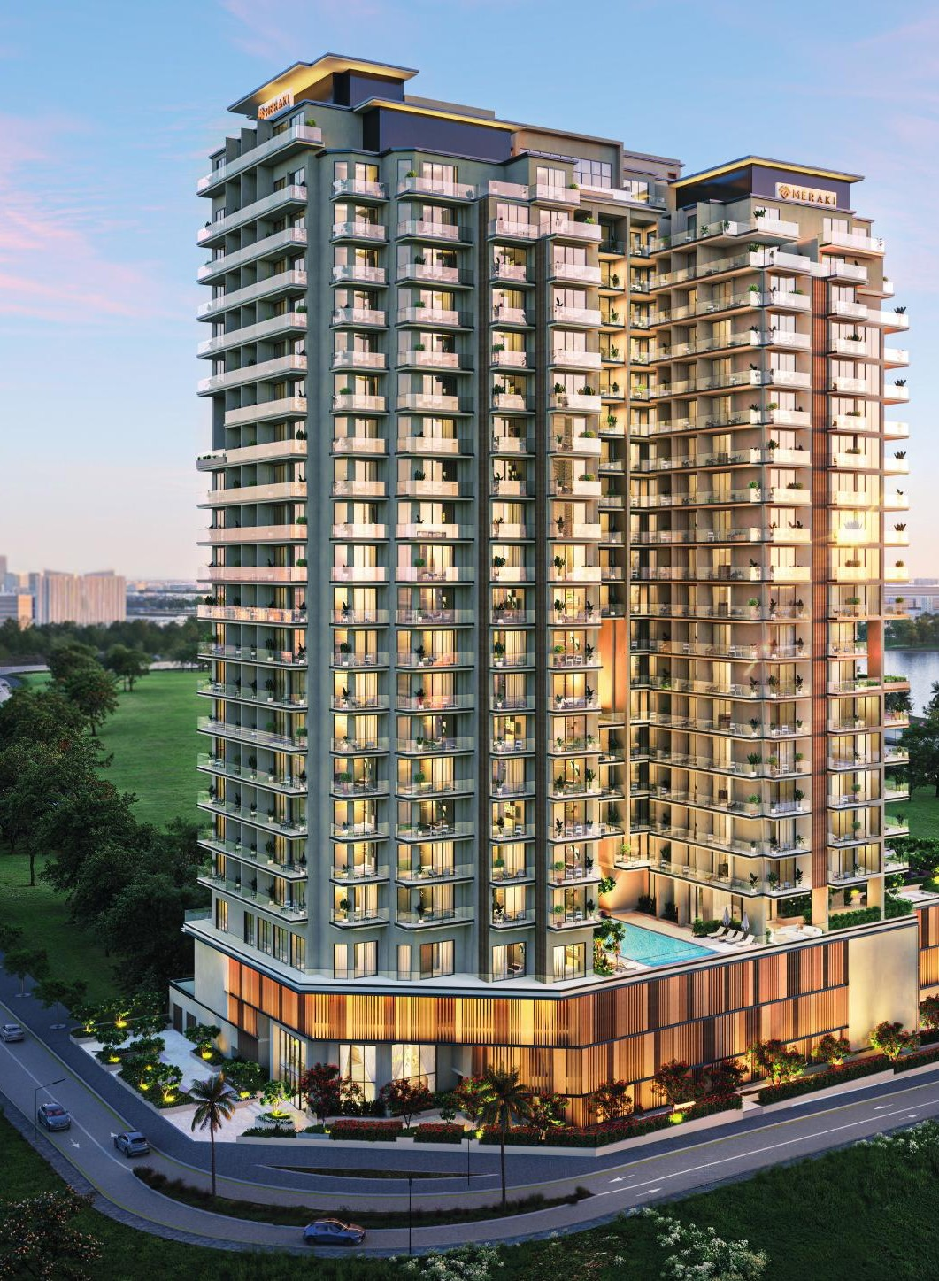
NIRVANA RESIDENCES I
Come Home
to Harmony
Harmony is a word often used and rarely experienced. It is the quiet confidence born of balance — when competing yet desirable qualities no longer pull against each other but settle into place. Your home. Your time. Your life.
Nirvana Residences I is built on this belief. A 22-storey residential tower in Me’aisem, it offers 392 residences — studios, one-, two-, and three-bedroom homes — each designed with the understanding that a home should support life, not compete with it.
392
Residences across
22 storeys
06

Slide 6
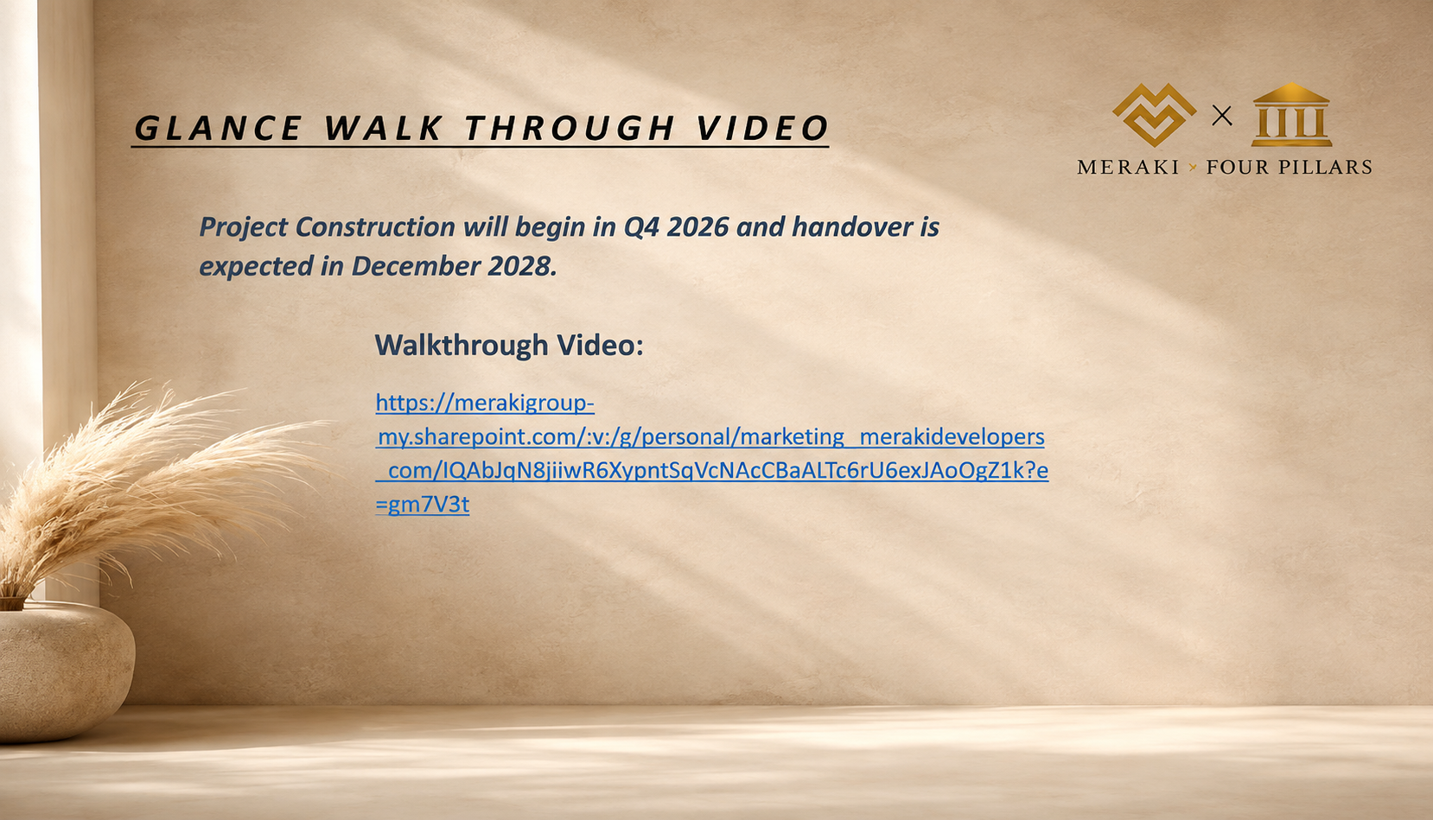

Slide 7
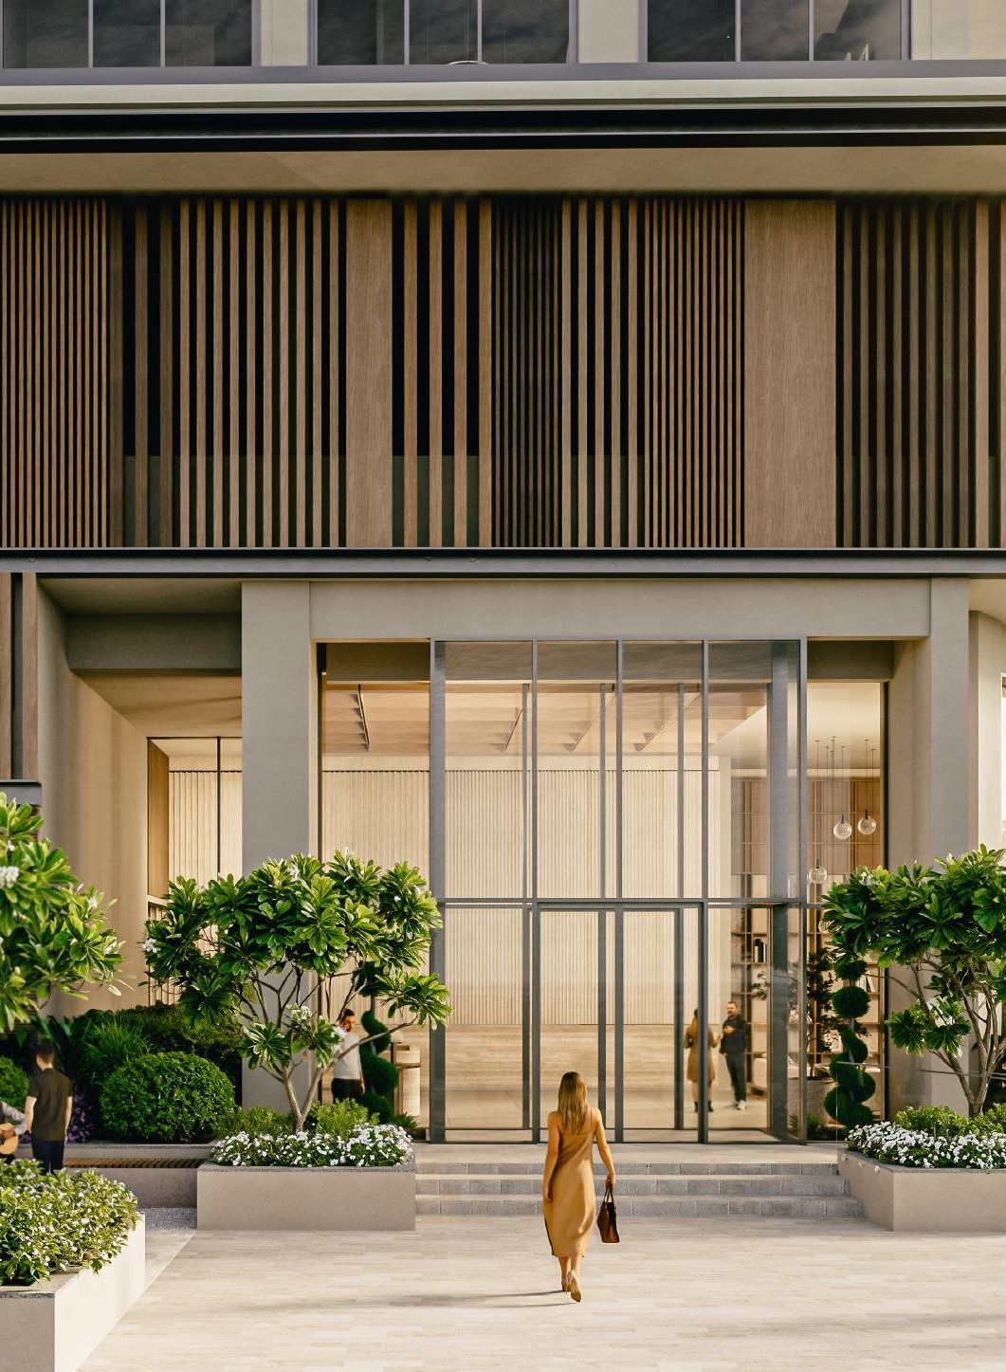
PROPERTY OVERVIEW
The Development
at a Glance
PLOT AREA
52,085.92 sqft
BUILDING DESCRIPTION
2 Basements + Ground + 2 Podiums + 19 Floors + Rooftop
RESIDENTIAL UNIT MIX
127
178
84
3
Studio Apartments
One-Bedroom
Two-Bedroom
Three-Bedroom
07

Slide 8
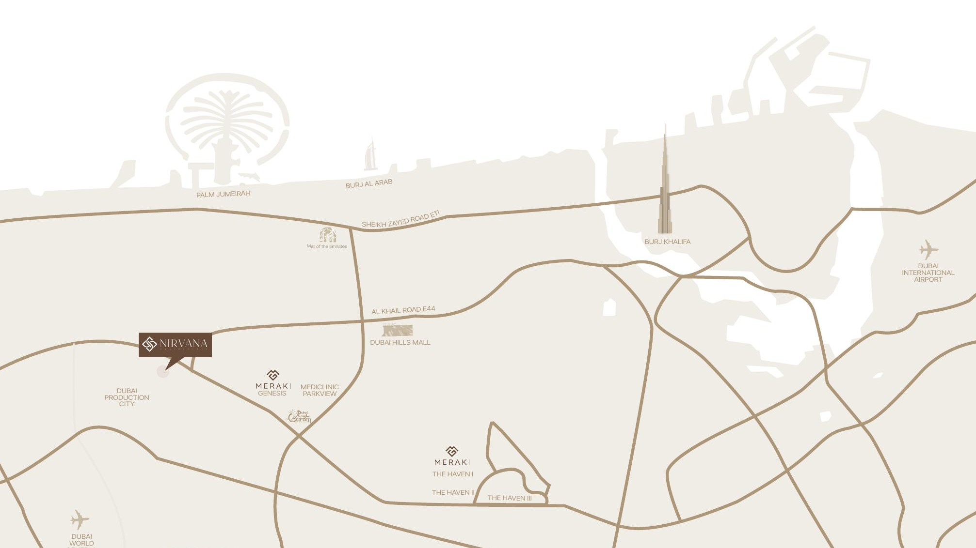
LOCATION CLOSE TO THE PULSE. CLOSER STILL TO THE CALM.
Connected to
Everything.
Removed From the Ordinary.
08

Slide 9
CONNECTIVITY
Minutes Away
From It All
25
25
11
MINS FROM
MINS FROM
MINS FROM
Dubai International Airport
Dubai World Central
Dubai Hills Mall
14
14
15
MINS FROM
MINS FROM
MINS FROM
Palm Jumeirah
Burj Al Arab
E11 / Sheikh Zayed Road
09

Slide 10
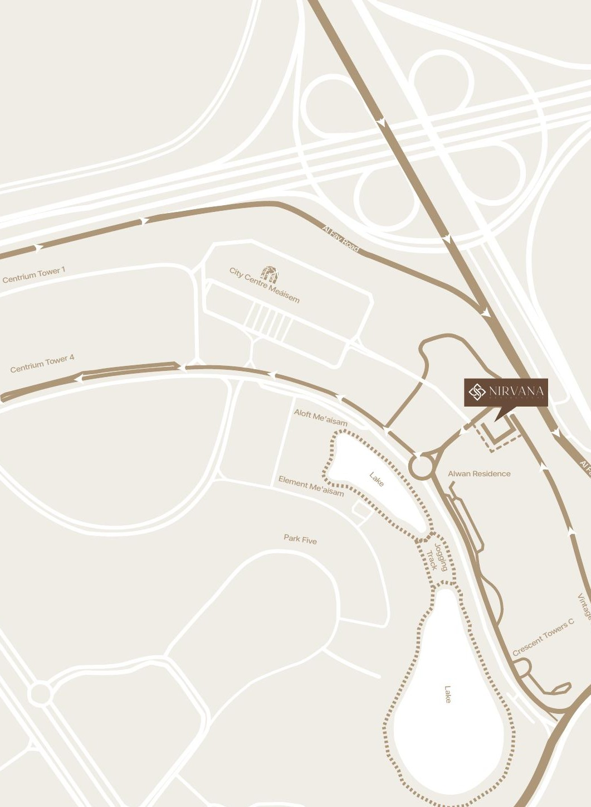
THE NEIGHBORHOOD
Grounded in
Essentials.
Elevated by Experiences.
Me’aisem is a community that offers what daily life requires — and what makes it richer. A direct connection to Al Fay Road ensures effortless movement to the rest of Dubai. Within walking distance, City Centre Me’aisem anchors daily life — groceries, cafés, cinema, salons, pharmacy — while Mediclinic Me’aisem covers everyday healthcare.
5
5
20
MINS · CITY CENTRE ME'AISEM
MINS · 2 LAKES + JOGGING TRACK
MINS · 10 PREMIUM SCHOOLS
10

Slide 11
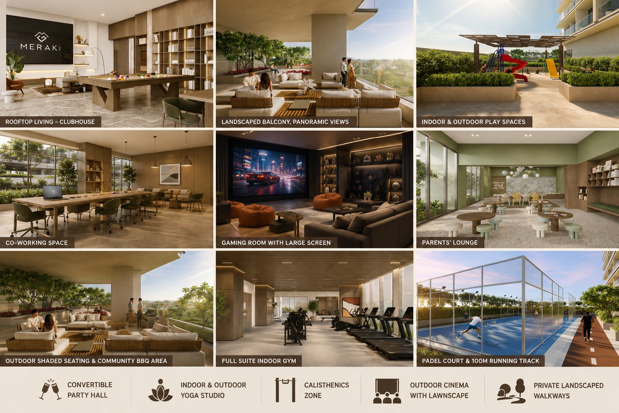

Slide 12
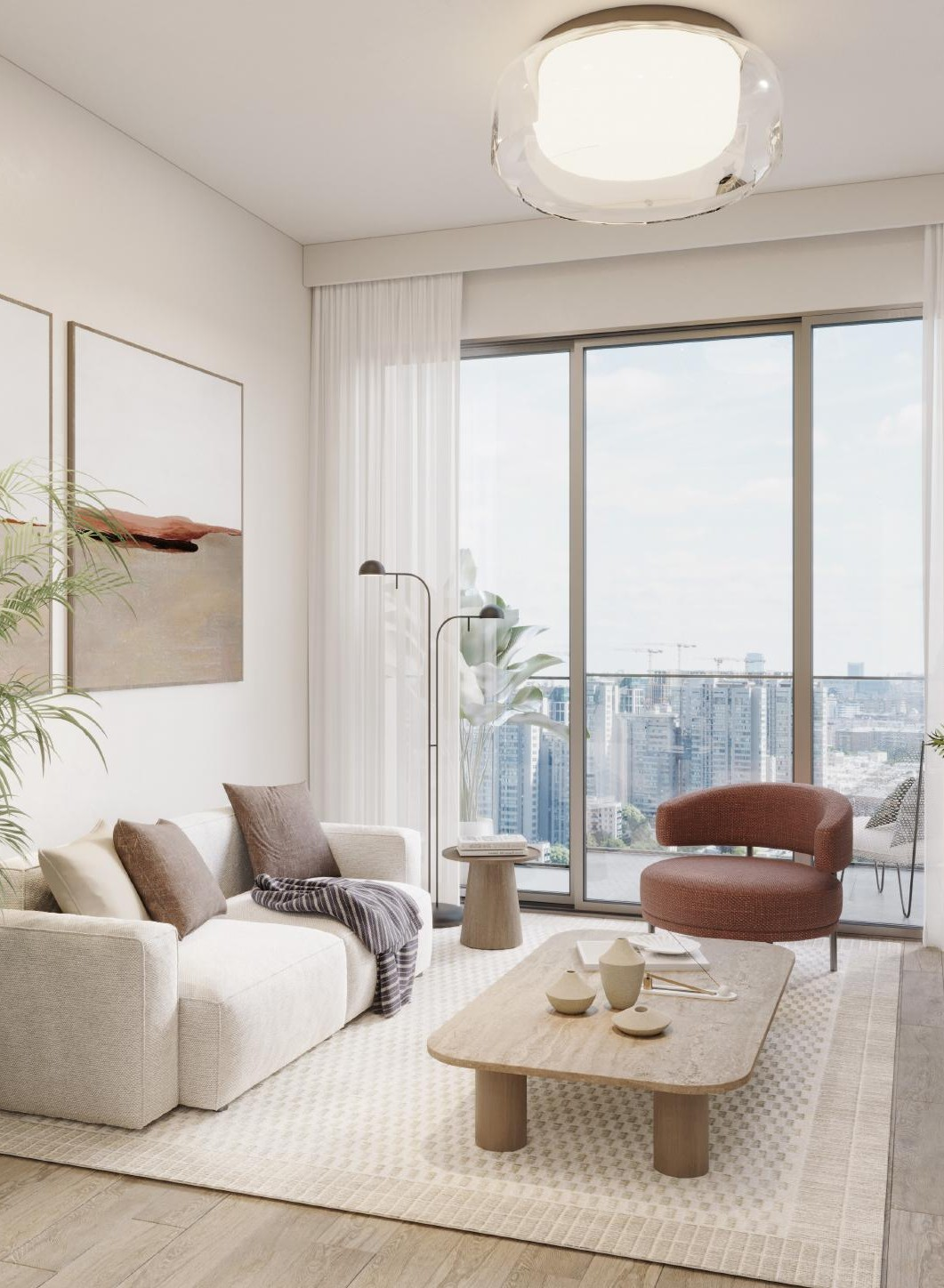
INTERIORS
Thoughtful Design.
Holistic Living.
Inside Nirvana Residences I, every residence is shaped by three principles: continuity, tactile depth, and composure. Spaces flow with a seamless rhythm — each room connected to the next in one coherent experience.
Materials are chosen for their honesty, their texture, their interplay of light and shadow. Finishes carry the signature attention to detail that Meraki Developers is known for — precision that you feel before you notice.
CONTINUITY
TACTILE DEPTH
COMPOSURE
15

Slide 13
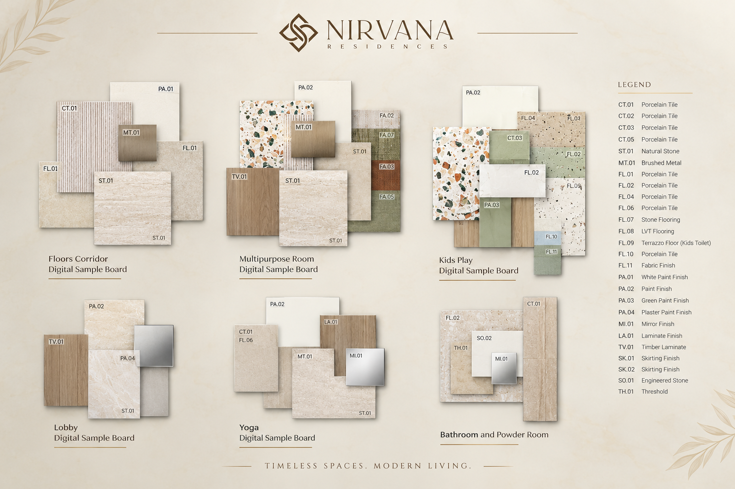

Slide 14
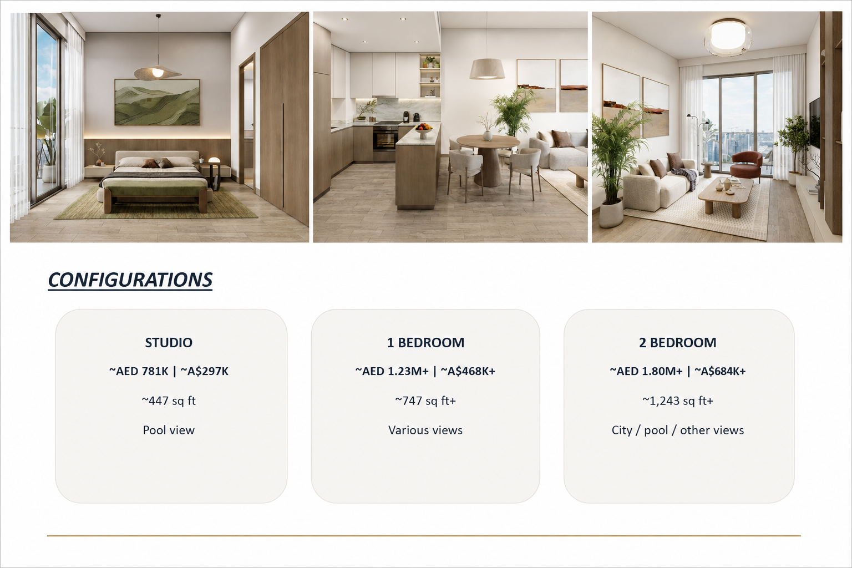
CONFIGURATIONS
STUDIO
~AED 781K | ~A$297K
~447 sq ft
Pool view
1 BEDROOM
~AED 1.23M+ | ~A$468K+
~747 sq ft+
Various views
2 BEDROOM
~AED 1.80M+ | ~A$684K+
~1,243 sq ft+
City / pool / other views

Slide 15
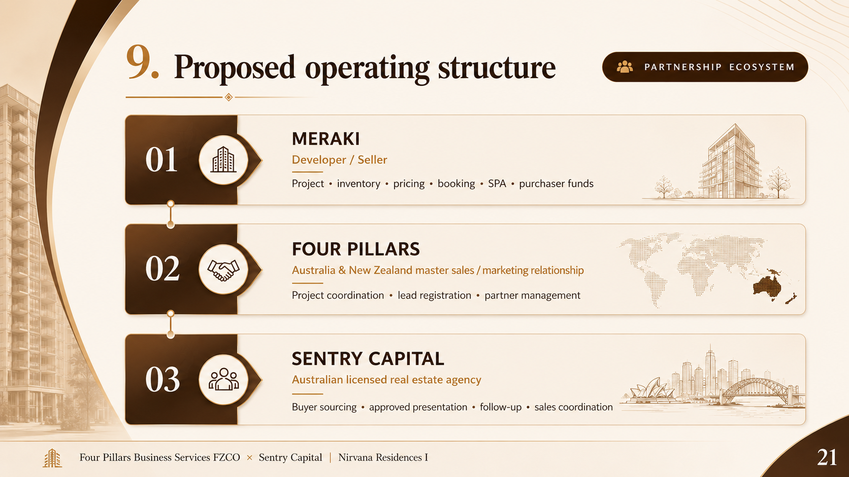

Slide 16
